Slide 1

Healthcare Analysis
Analysis Of Dialysis Patients

Slide 2
Objective :
The project aims to address and analyse behavioral data, where we can predict treatment outcomes and potential risks for chronic illness. The health data collected can be used for risk scoring, readmission prediction and prevention, predicting infection and deterioration and so much more at the individual patient level.

Slide 3
Requirements :
Deployment Environment
Building Of Predictive Healthcare models
Use of various analytical methods :
Descriptive Analytics
Diagnostic Analytics
Predictive Analytics
Discovery Analytics
Prescriptive Analytics

Slide 4



Tools Used:

Slide 5
Projections :
Number Of Patients across various summaries
Profit Vs Non-Profit Stats
Top 3 Chain Organizations in terms of no. of dialysis stations
Dialysis Stations Stats
Average Payment Reduction Rate

Slide 6
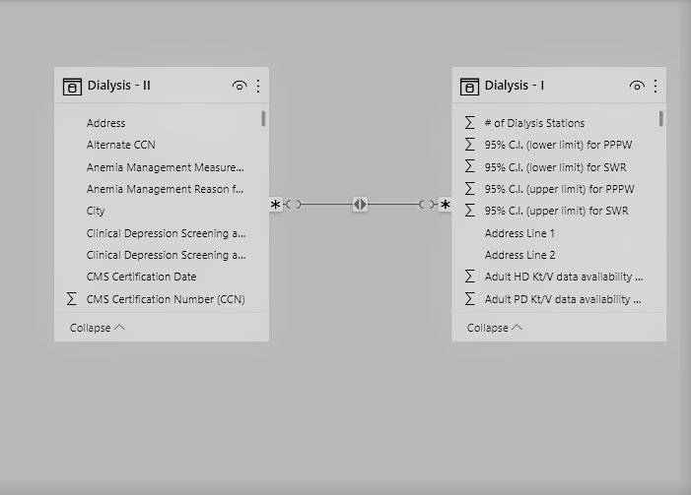
Data Model :

Slide 7
Overview :
No of Patients across Various Summaries : This Key Performance Indicator(KPI) shows
how many patients are there across various
summaries.
Profit Vs Non-Profit Stats : Profit/Non-Profit stats gives us insight over
how much profitable facilities are there
and what percent they hold.
Top 3 Chain Org in terms
Of dialysis stations : This KPI shows top three chain
organizations that hold highest no of
dialysis stations.
# of Category Text – As Expected : There are various category text and
they include many levels like ASEXPECTED
WORST THEN EXPECTED , this KPI has been
filtered by As expected for all category
text.

Slide 8
Dialysis Station Stats :
Total number of dialysis stations provided by each state.
# Score Applied – Improvement :
There are various score applied measures and we want only those measures that need improvement so here filtered only measure Score Appiled is “Improvement”
Top 3 Facilities by Total Performance : score
Just filtered facilities that has maximum total performance score.
Average Payment Reduction Rate :
Total avg payment reduction rate is 0.32%

Slide 9
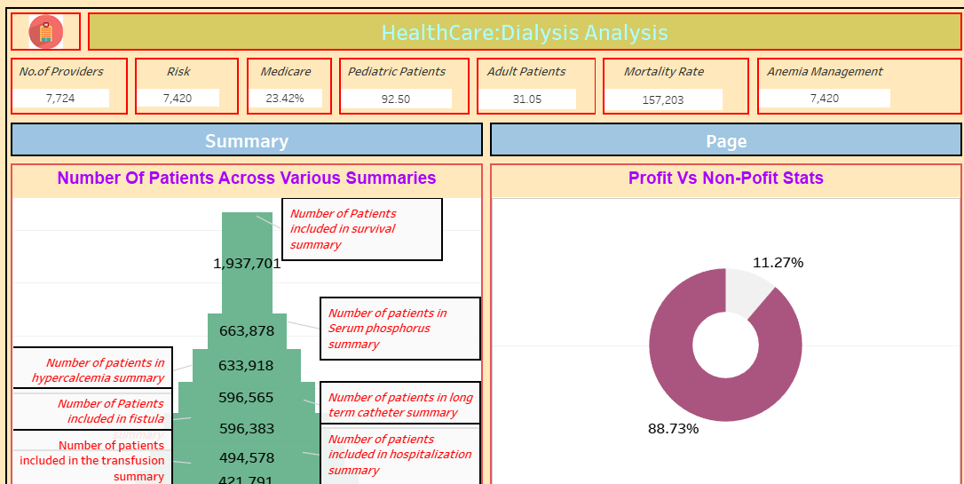
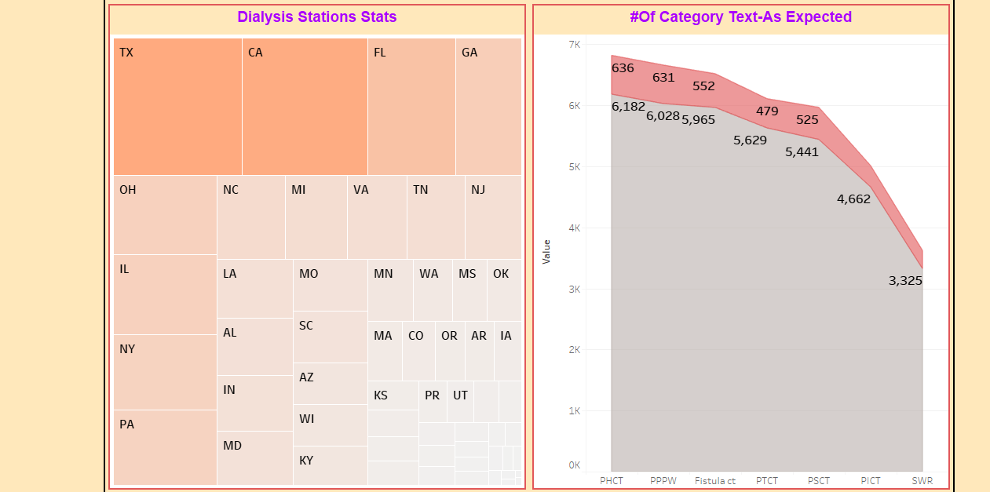
TABLEAU DASHBAORD

Slide 10
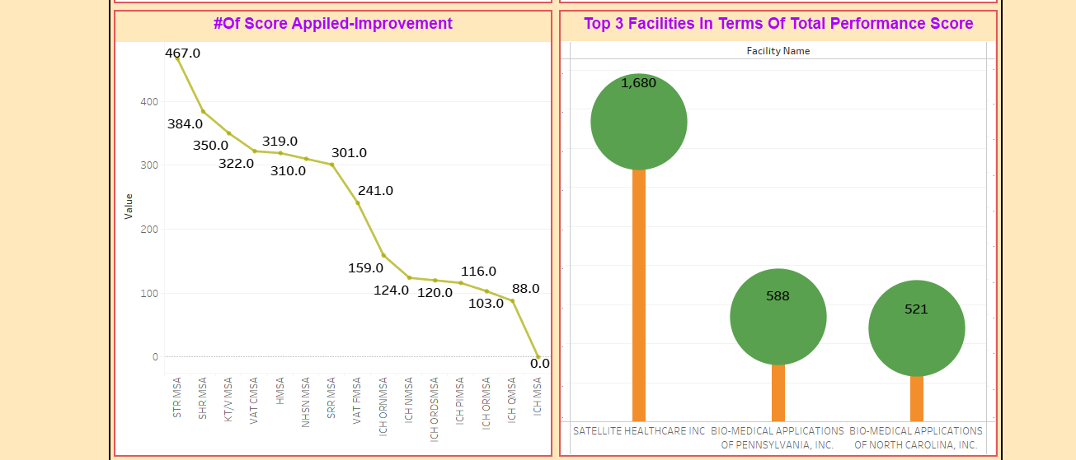
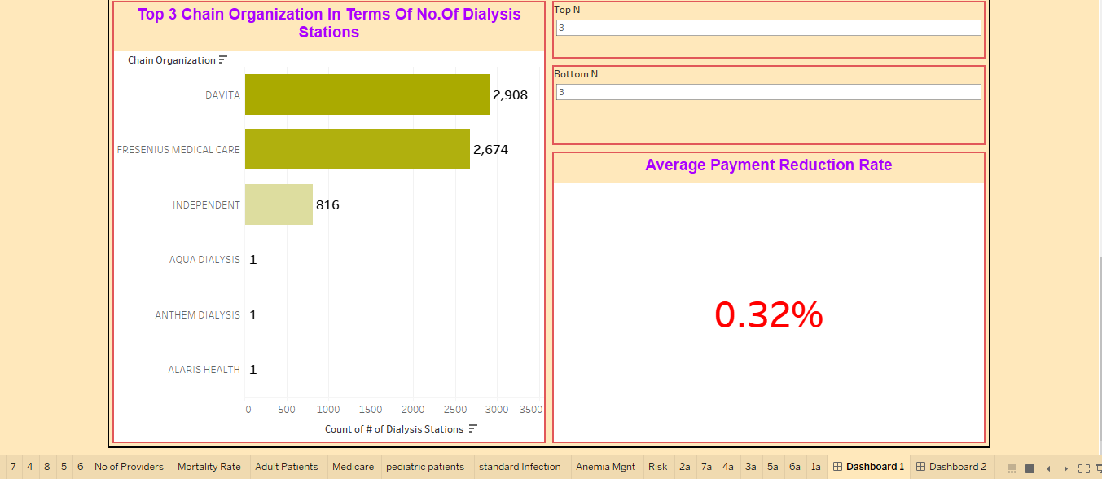

Slide 11
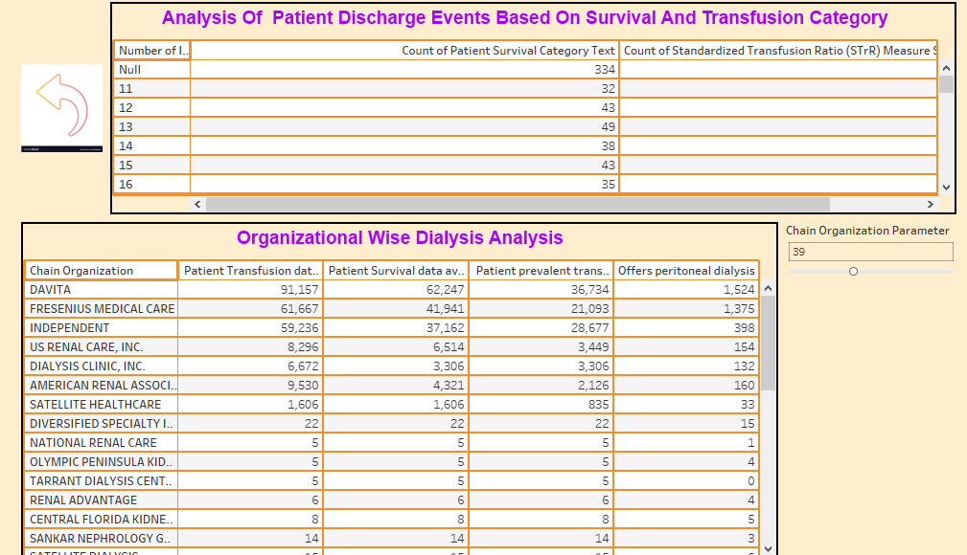

Slide 12
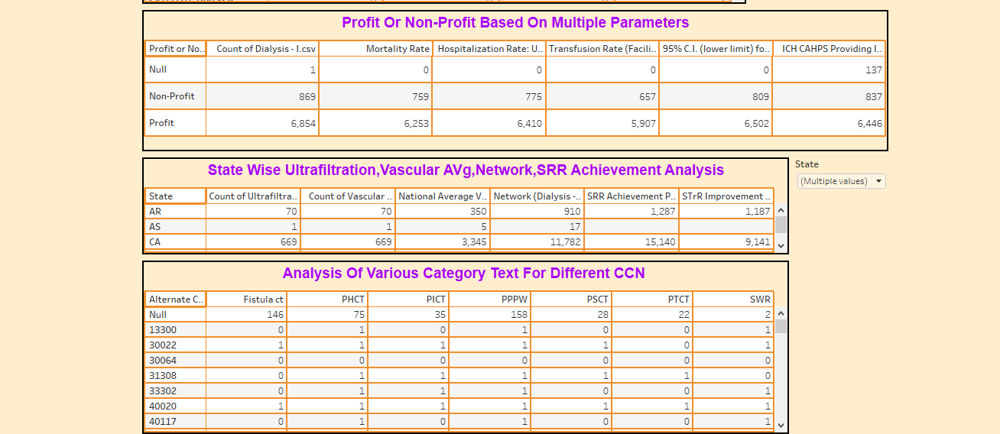
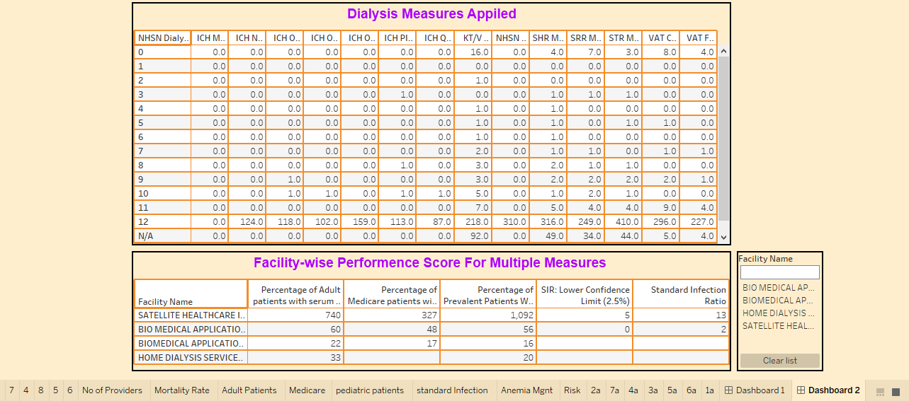

Slide 13
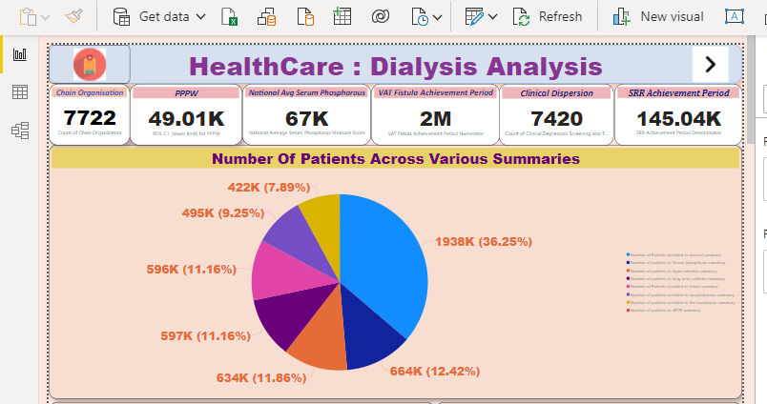
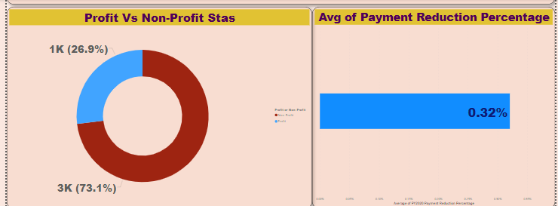
POWERBI REPORT

Slide 14
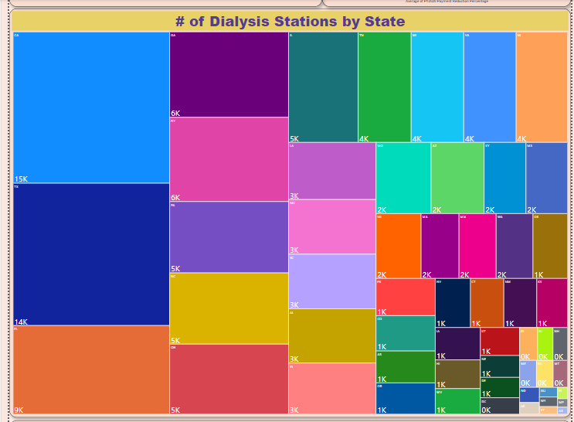
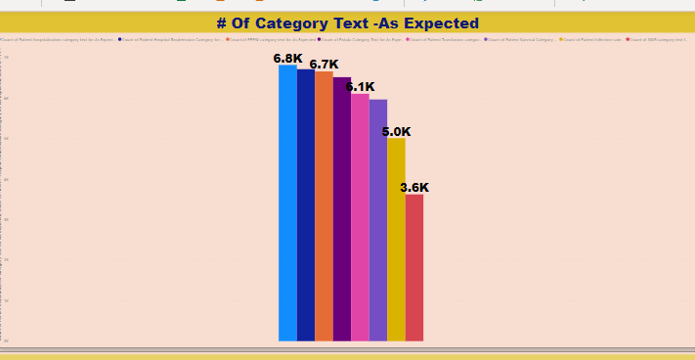
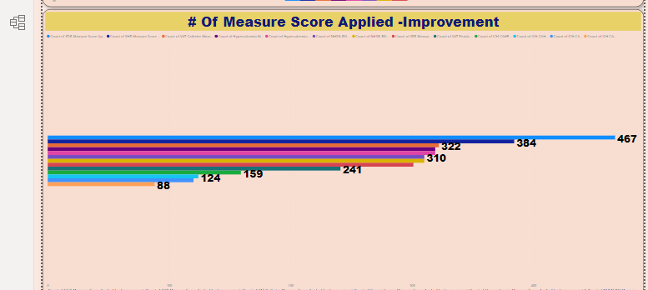
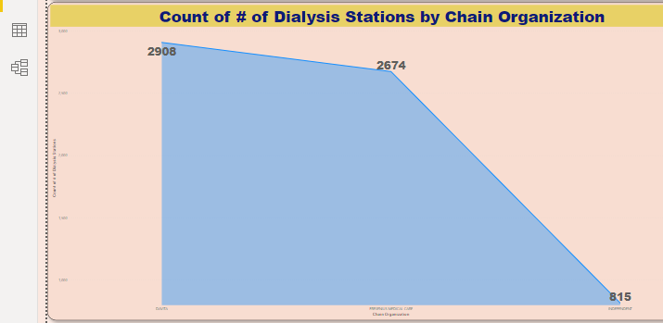
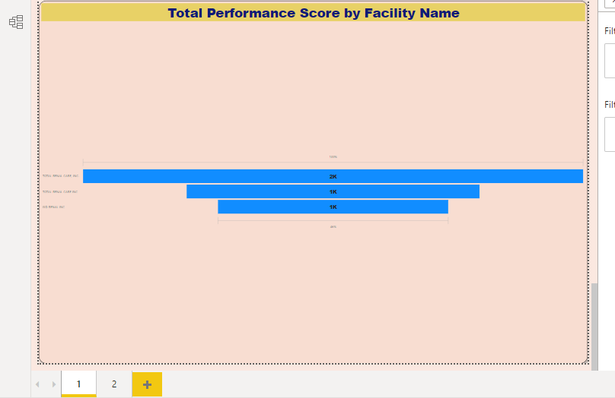

Slide 15
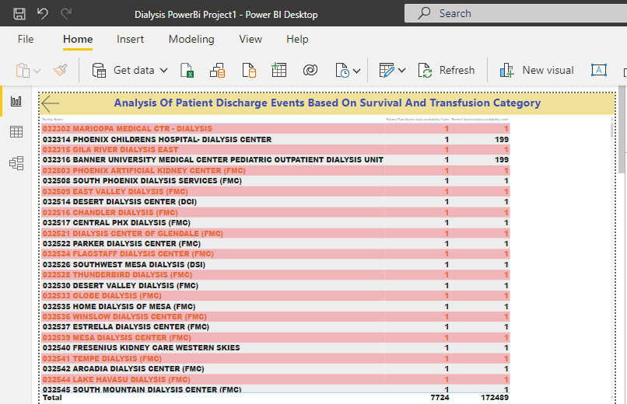

Slide 16
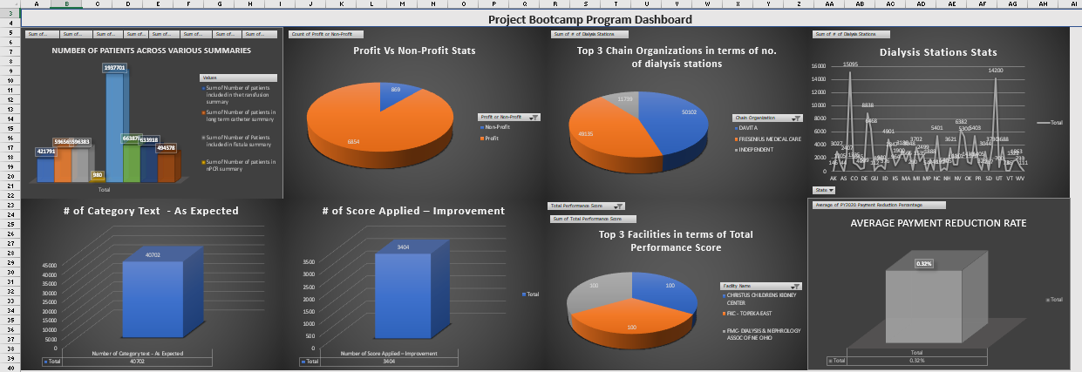
EXCEL DASHBOARD

Slide 17
Conclusion :
From the analysis of above dashboards and reports we can analyse the health information of each and every patient effectively that helps to improve the healthcare delivery.

Slide 18
Thank You

